Slide 1


FrienDo
Crearea unei platforme de socializare web
Au efectuat: Garștea Alexandr TI-206
Raileanu Daniel TI-206
Coordonator: asist. univ. Buldumac Oleg

Slide 2







Slide 3
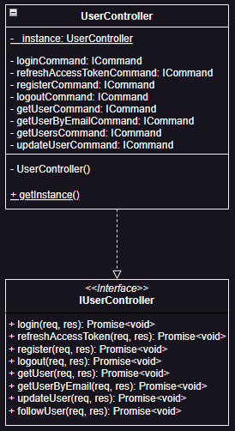
export class UserController implements IUserController {
private static _instance: UserController;
private constructor() {}
static getInstance() {
if (this._instance) {
return this._instance;
}
this._instance = new UserController();
return this._instance;
}
}
export default UserController.getInstance();

Slide 4
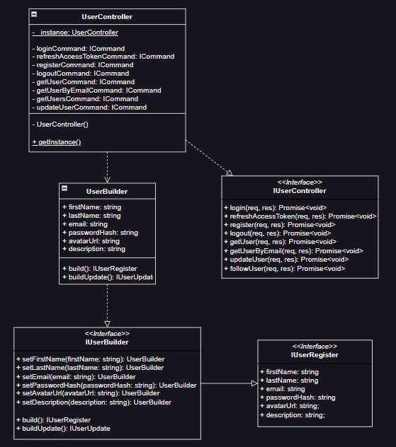
export class UserBuilder implements IUserBuilder {
public firstName: string;
public lastName: string;
public email: string;
public passwordHash: string;
public avatarUrl: string;
public description: string;
constructor() {}
public setFirstName(firstName: string): UserBuilder {}
public setLastName(lastName: string): UserBuilder {}
public setEmail(email: string): UserBuilder {}
public setPasswordHash(passwordHash: string): UserBuilder {}
public setAvatarUrl(avatarUrl: string): UserBuilder {}
public setDescription(description: string): UserBuilder {}
public build(): IUserRegister {
return {
firstName: this.firstName,
lastName: this.lastName,
email: this.email,
passwordHash: this.passwordHash,
avatarUrl: this.avatarUrl,
};
}
public buildUpdate(): IUserUpdate {
return {
firstName: this.firstName,
lastName: this.lastName,
email: this.email,
avatarUrl: this.avatarUrl,
description: this.description,
};
}
}

Slide 5
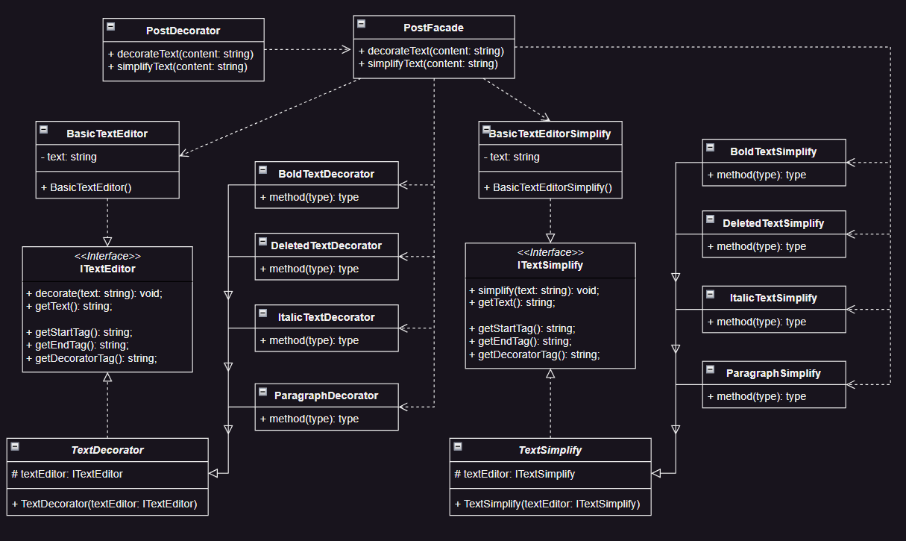
export abstract class TextDecorator implements ITextEditor {
protected textEditor: ITextEditor;
constructor(textEditor: ITextEditor) {
this.textEditor = textEditor;
}
decorate(text: string): void {
this.textEditor.decorate(text);
}
getText(): string {
return this.textEditor.getText();
}
abstract getStartTag(): string;
abstract getEndTag(): string;
abstract getDecoratorTag(): string;
}
export class BoldTextDecorator extends TextDecorator {
decorate(text: string) {
const replacedTagsText = text
.replaceAll(this.getStartTag(),
this.getDecoratorTag())
.replaceAll(this.getEndTag(),
this.getDecoratorTag());
super.decorate(replacedTagsText);
}
getStartTag(): string {
return '<strong>';
}
getEndTag(): string {
return '</strong>';
}
getDecoratorTag(): string {
return '**';
}
}

Slide 6
export class PostFacade {
decorateText(content: string) {
const editor: ITextEditor = new BasicTextEditor();
const decoratorsList: ITextEditor[] = [
new decorators.BoldTextDecorator(editor),
new decorators.ItalicTextDecorator(editor),
new decorators.DeletedTextDecorator(editor),
new decorators.ParagraphDecorator(editor),
];
let decoratedContent = content;
decoratorsList.forEach((decorator) => {
decorator.decorate(decoratedContent);
decoratedContent = decorator.getText();
});
return editor.getText();
}
simplifyText(content: string) {
const editor: ITextSimplify = new BasicTextEditorSimplify();
const simplifyDecoratorsList: ITextSimplify[] = [
new simplifyDecorators.BoldTextSimplify(editor),
new simplifyDecorators.ItalicTextSimplify(editor),
new simplifyDecorators.DeletedTextSimplify(editor),
new simplifyDecorators.ParagraphSimplify(editor),
];
let decoratedContent = content;
simplifyDecoratorsList.forEach((decorator) => {
decorator.simplify(decoratedContent);
decoratedContent = decorator.getText();
});
return editor.getText();
}
}

Slide 7
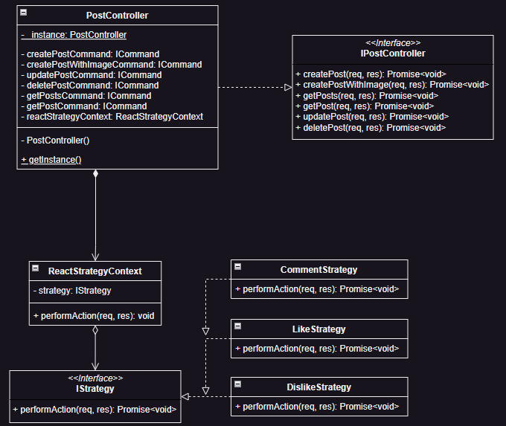
export class ReactStrategyContext {
private strategy: IStrategy;
constructor() {
this.strategy = new strategies.like();
}
public performAction(req: Request, res: Response): void {
const { reactionType } = req.params;
switch (reactionType) {
case 'like':
this.strategy = new strategies.like();
break;
case 'dislike':
this.strategy = new strategies.dislike();
break;
case 'comment':
this.strategy = new strategies.comment();
break;
default:
throw new Error('Invalid reaction type.');
}
this.strategy.performAction(req, res);
}
}
export class CommentStrategy implements IStrategy {
public async performAction(req: Request, res: Response): Promise<void> {}
}
export class DislikeStrategy implements IStrategy {
public async performAction(req: Request, res: Response): Promise<void> {}
}
export class LikeStrategy implements IStrategy {
public async performAction(req: Request, res: Response): Promise<void> {}
}

Slide 8
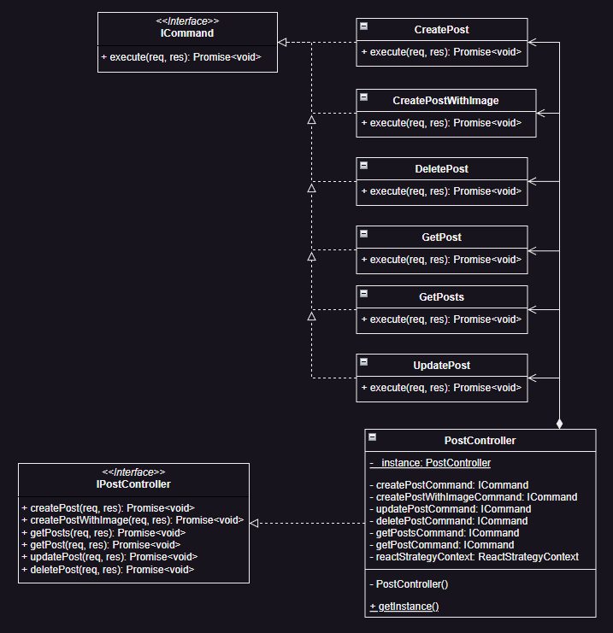
export class CreatePost implements ICommand {
public async execute(req: Request, res: Response): Promise<void> {}
}
export class CreatePostWithImage implements ICommand {
public async execute(req: Request, res: Response): Promise<void> {}
}
export class DeletePost implements ICommand {
public async execute(req: Request, res: Response): Promise<void> {}
}
export class GetPost implements ICommand {
public async execute(req: Request, res: Response): Promise<void> {}
}
export class GetPosts implements ICommand {
public async execute(req: Request, res: Response): Promise<void> {}
}
export class UpdatePost implements ICommand {
public async execute(req: Request, res: Response): Promise<void> {}
}

Slide 9
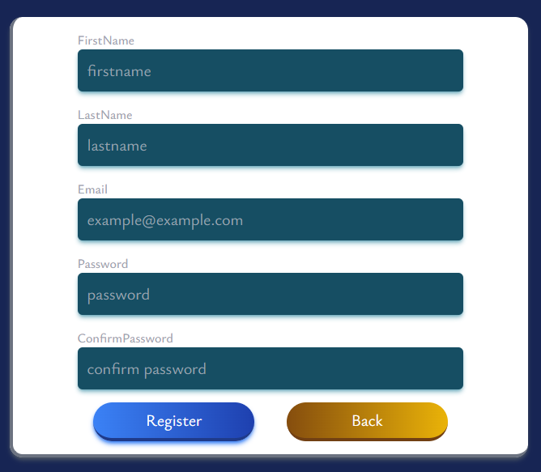
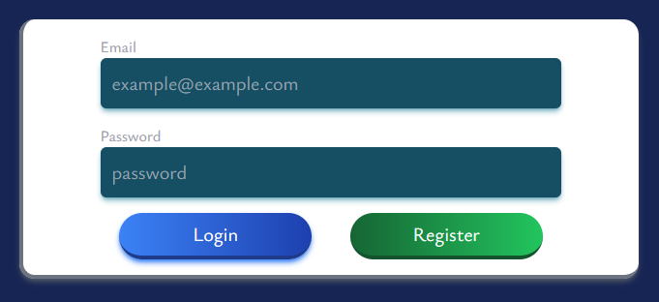

Slide 10
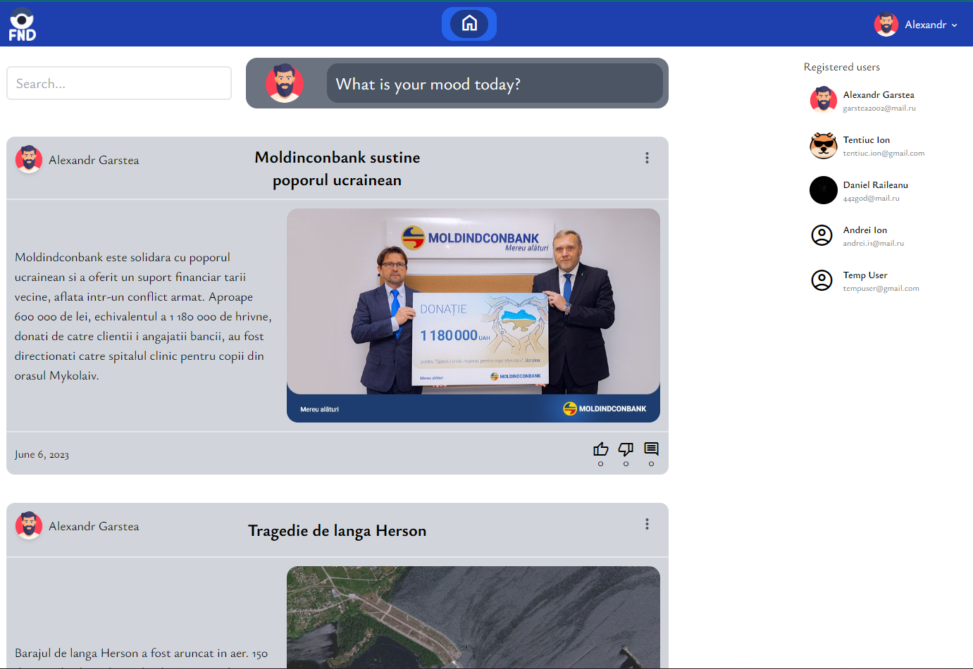

Slide 11
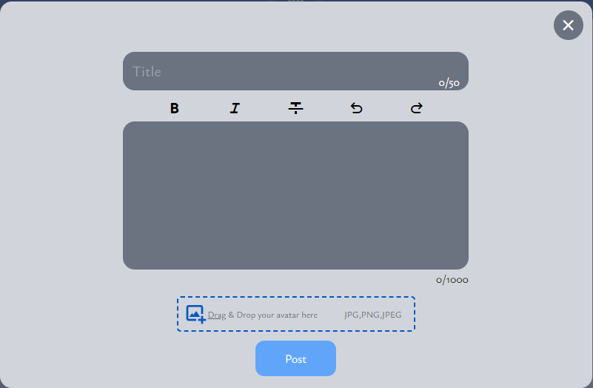

Slide 12
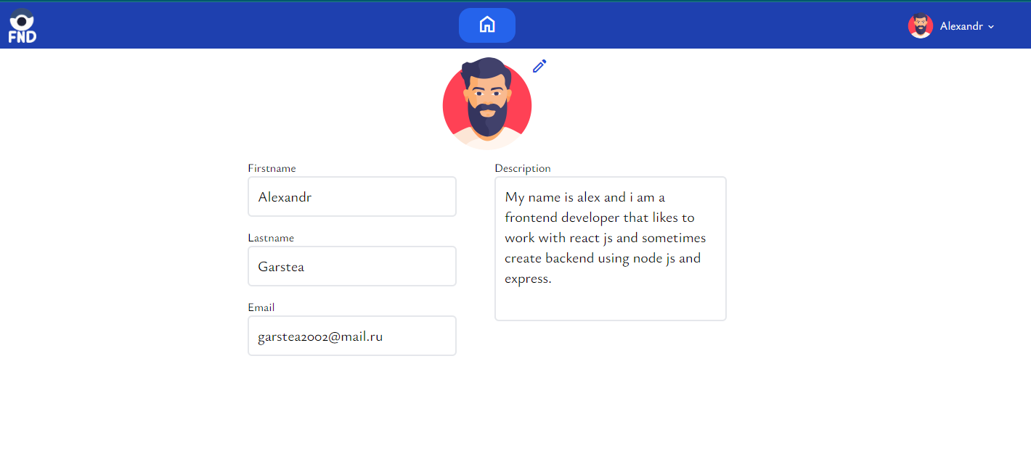

Slide 13


Slide 14
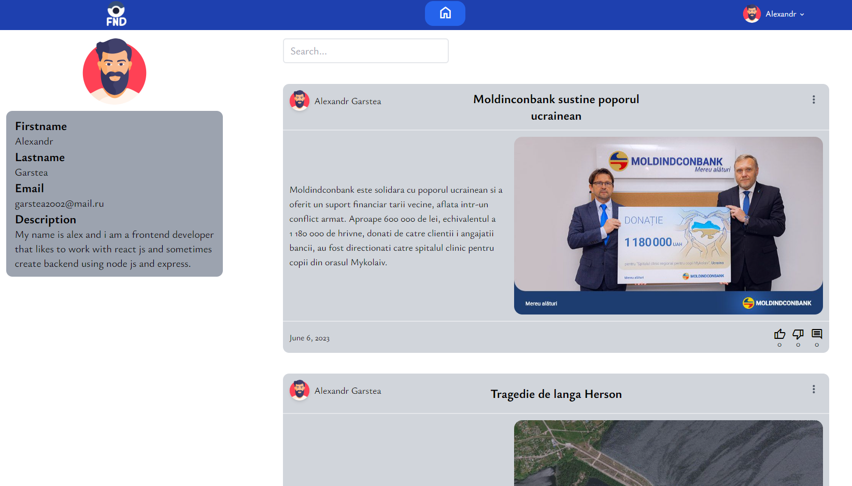

Slide 15


